Slide 1



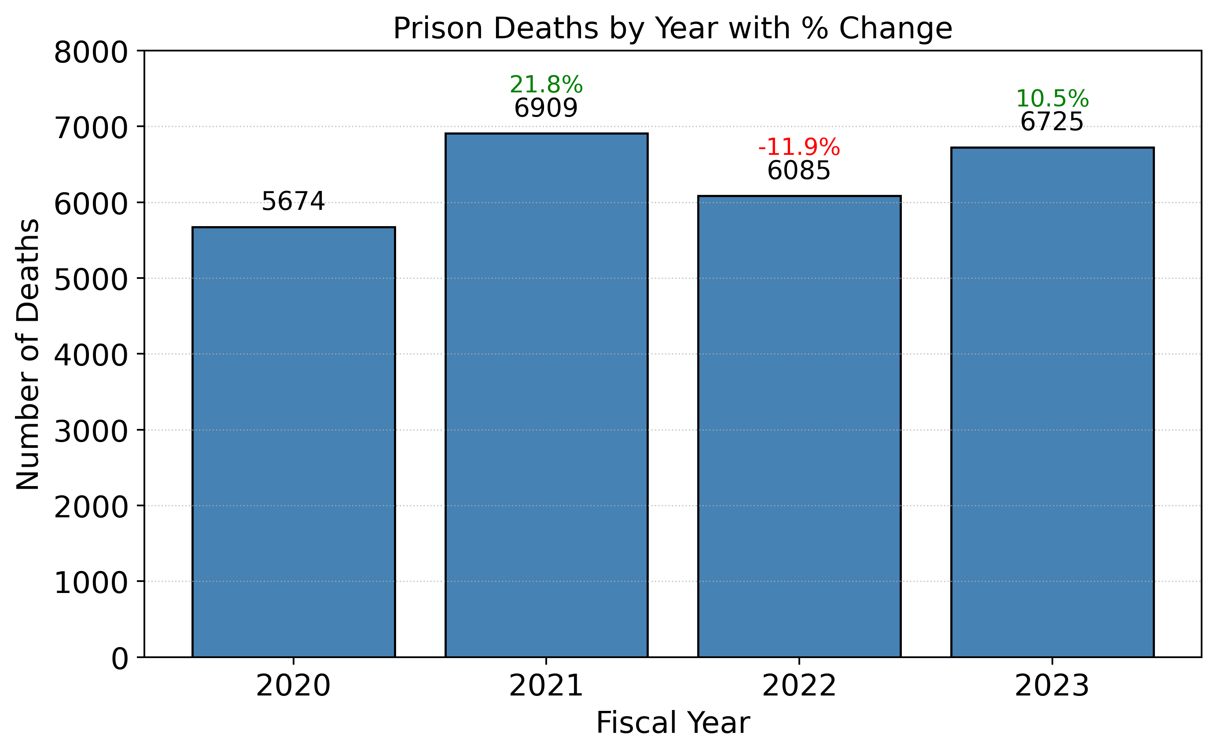
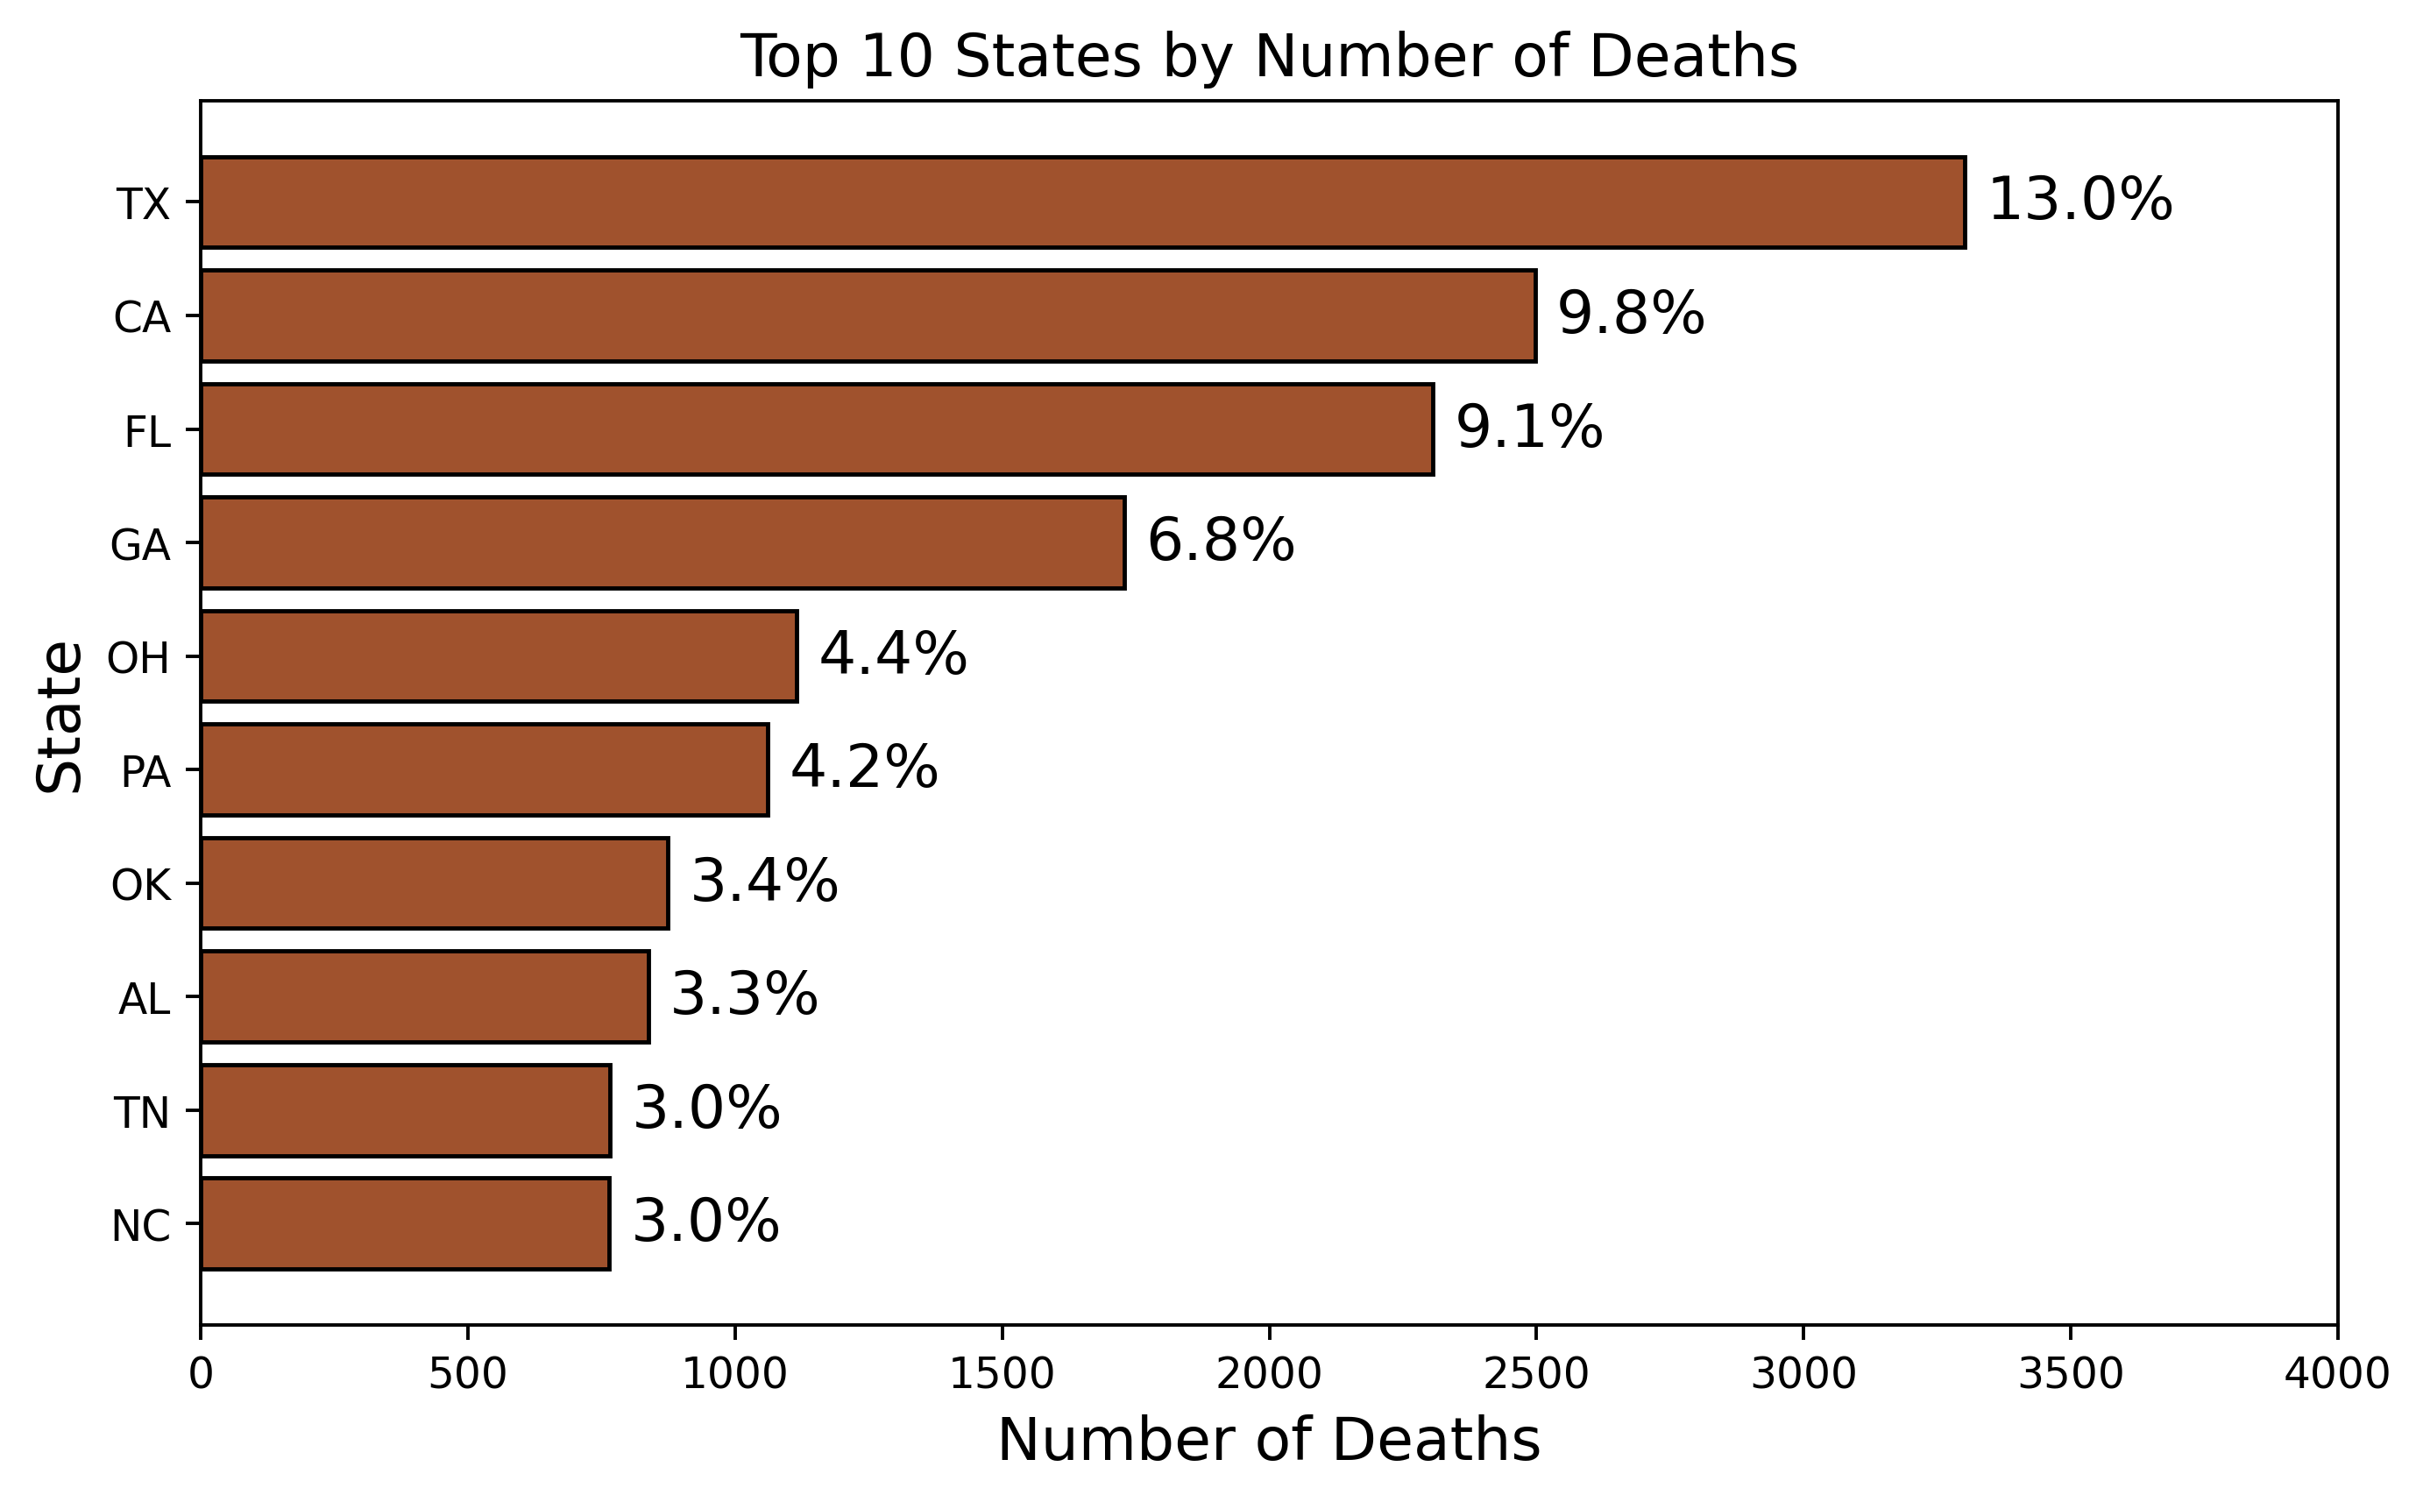
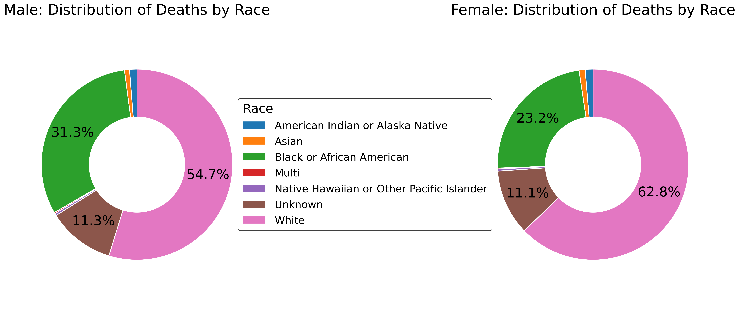
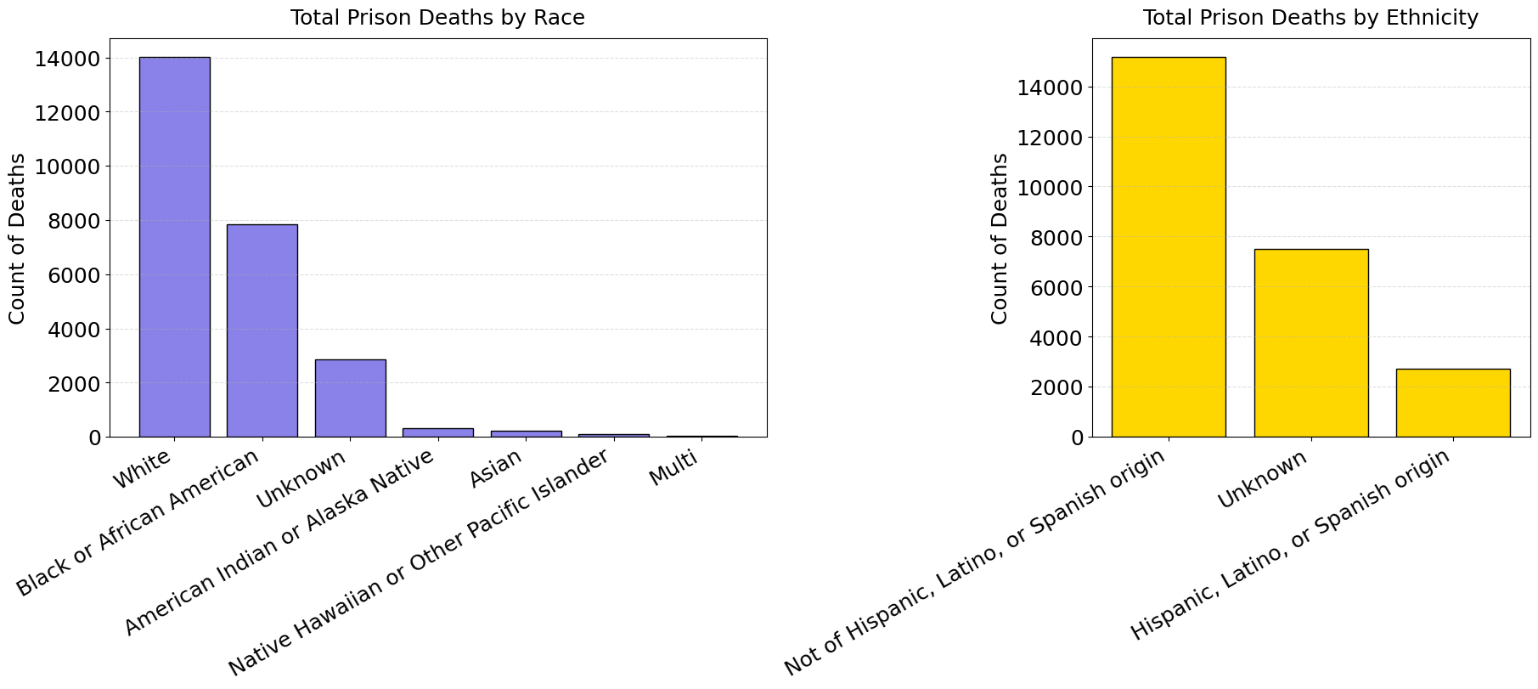

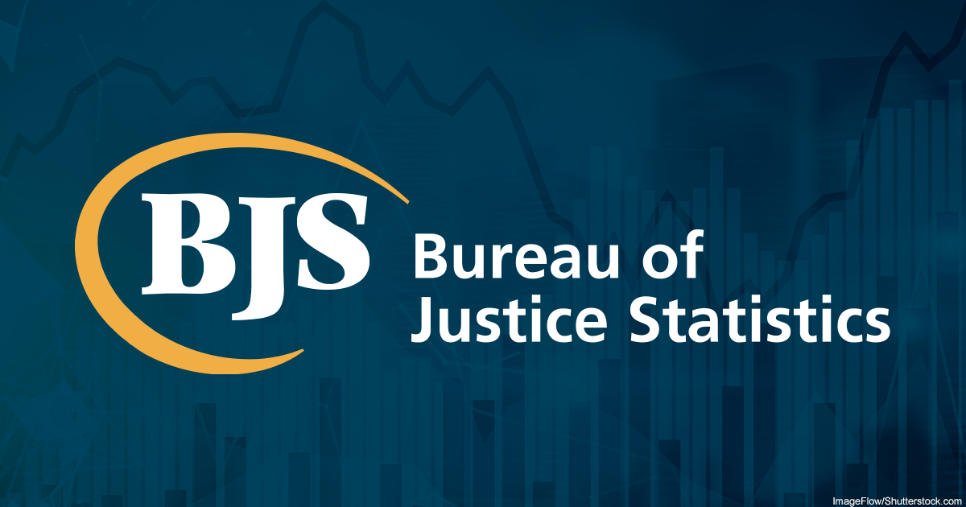

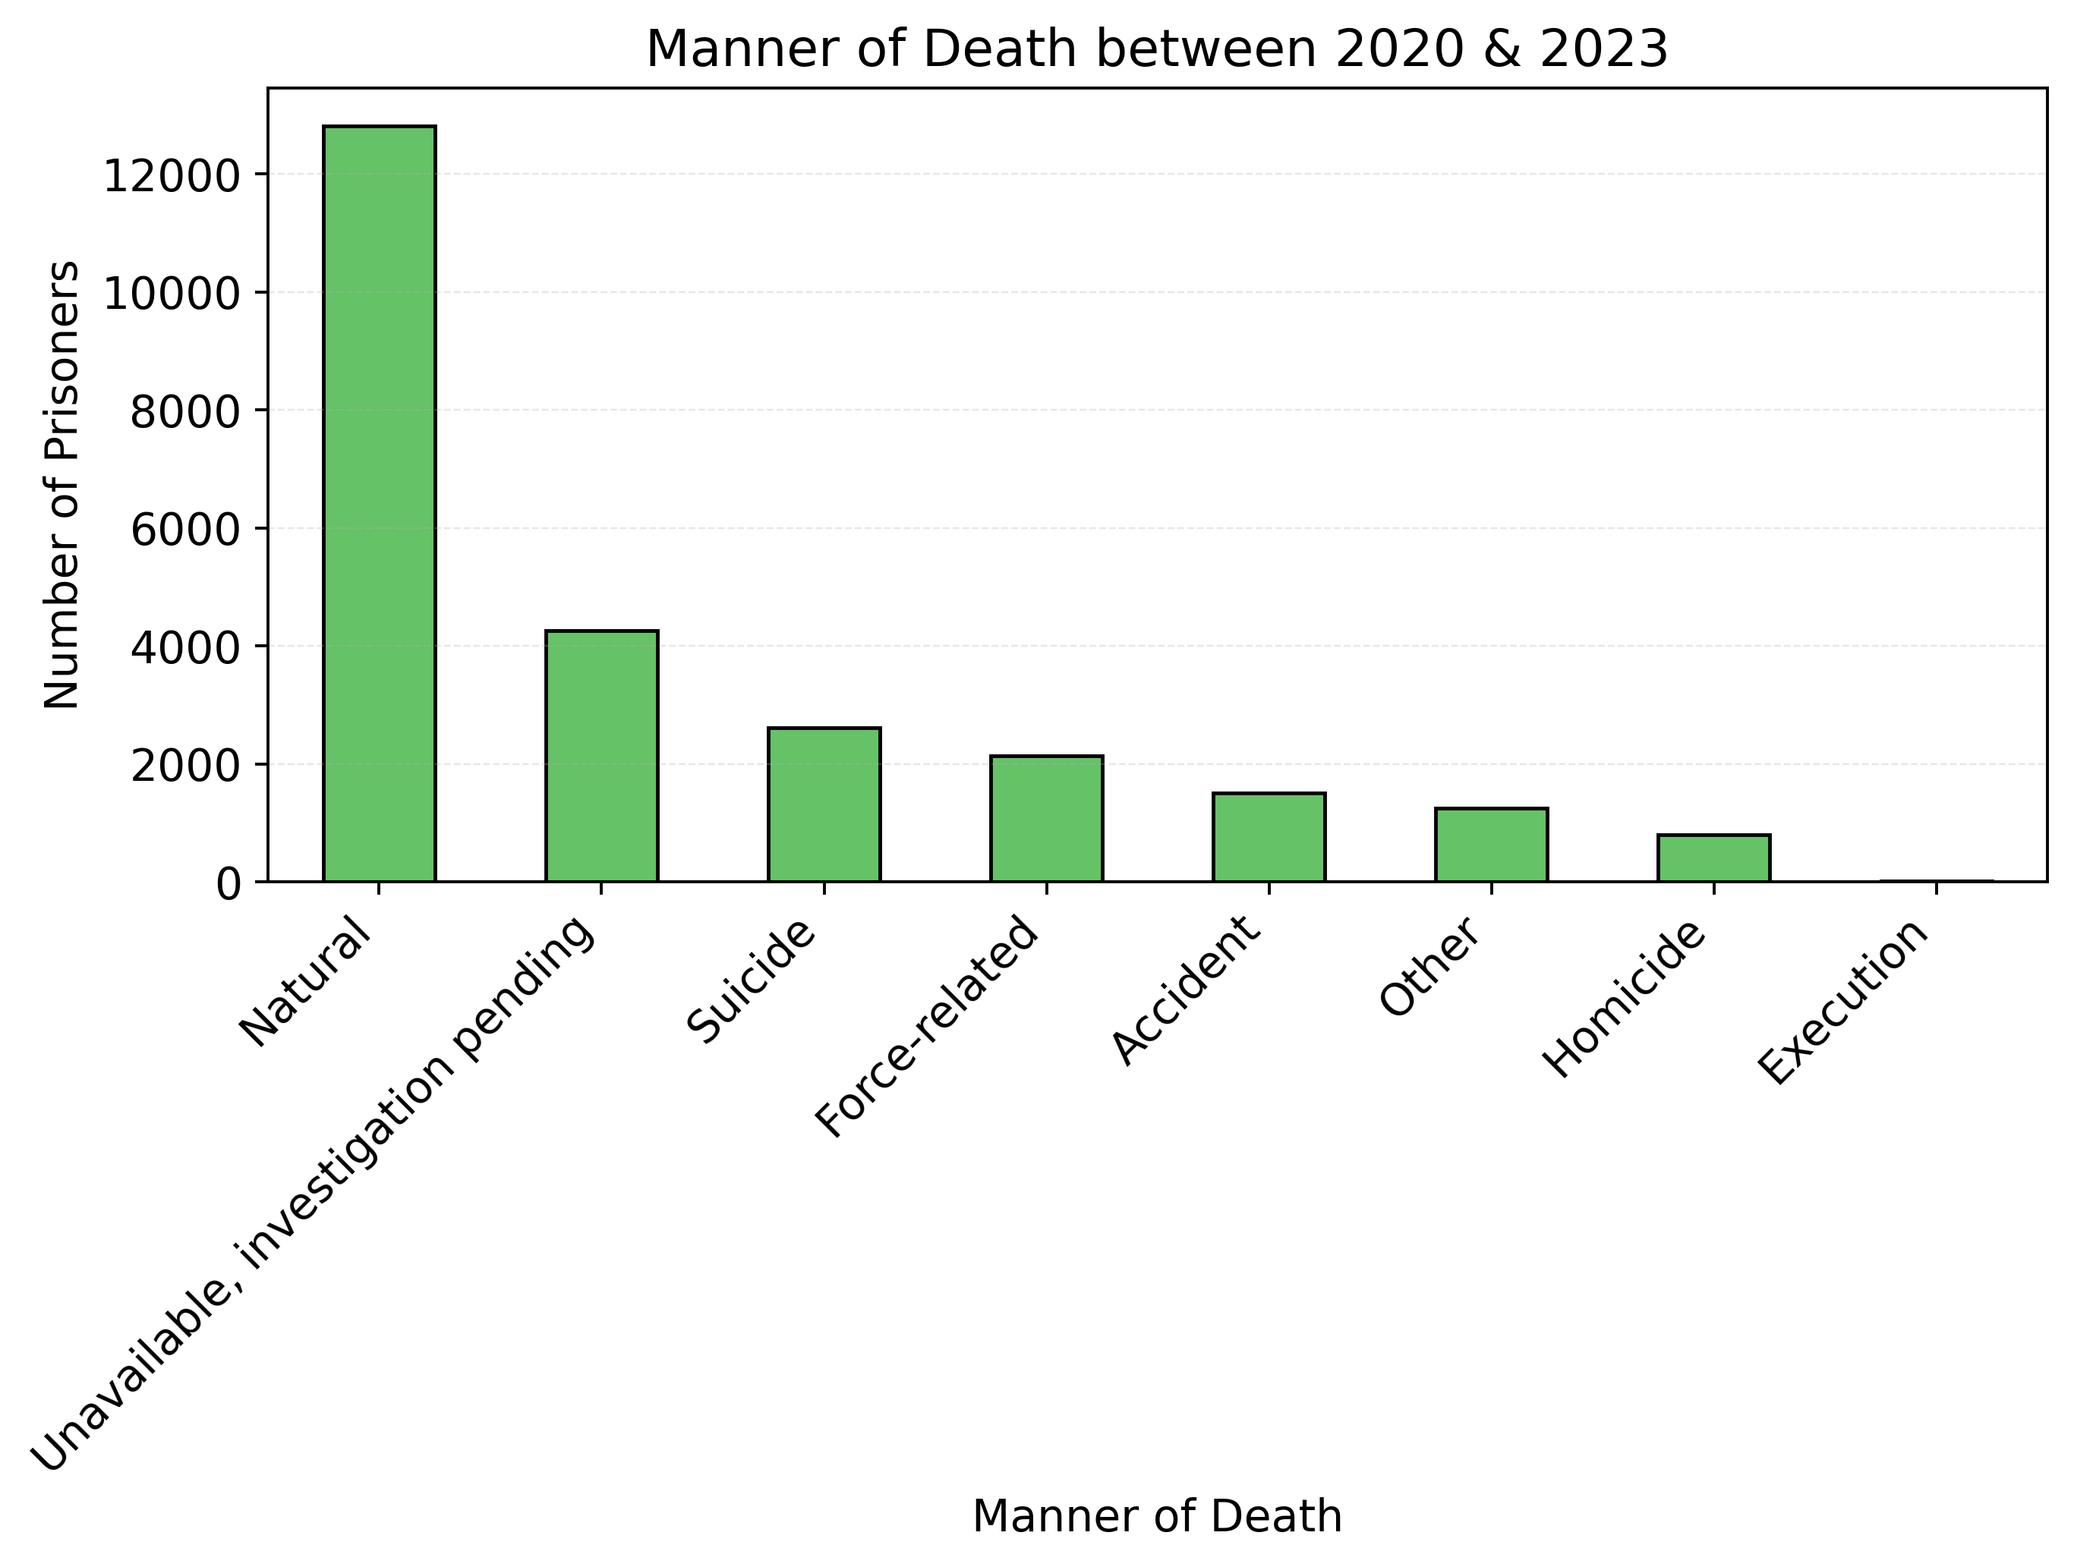
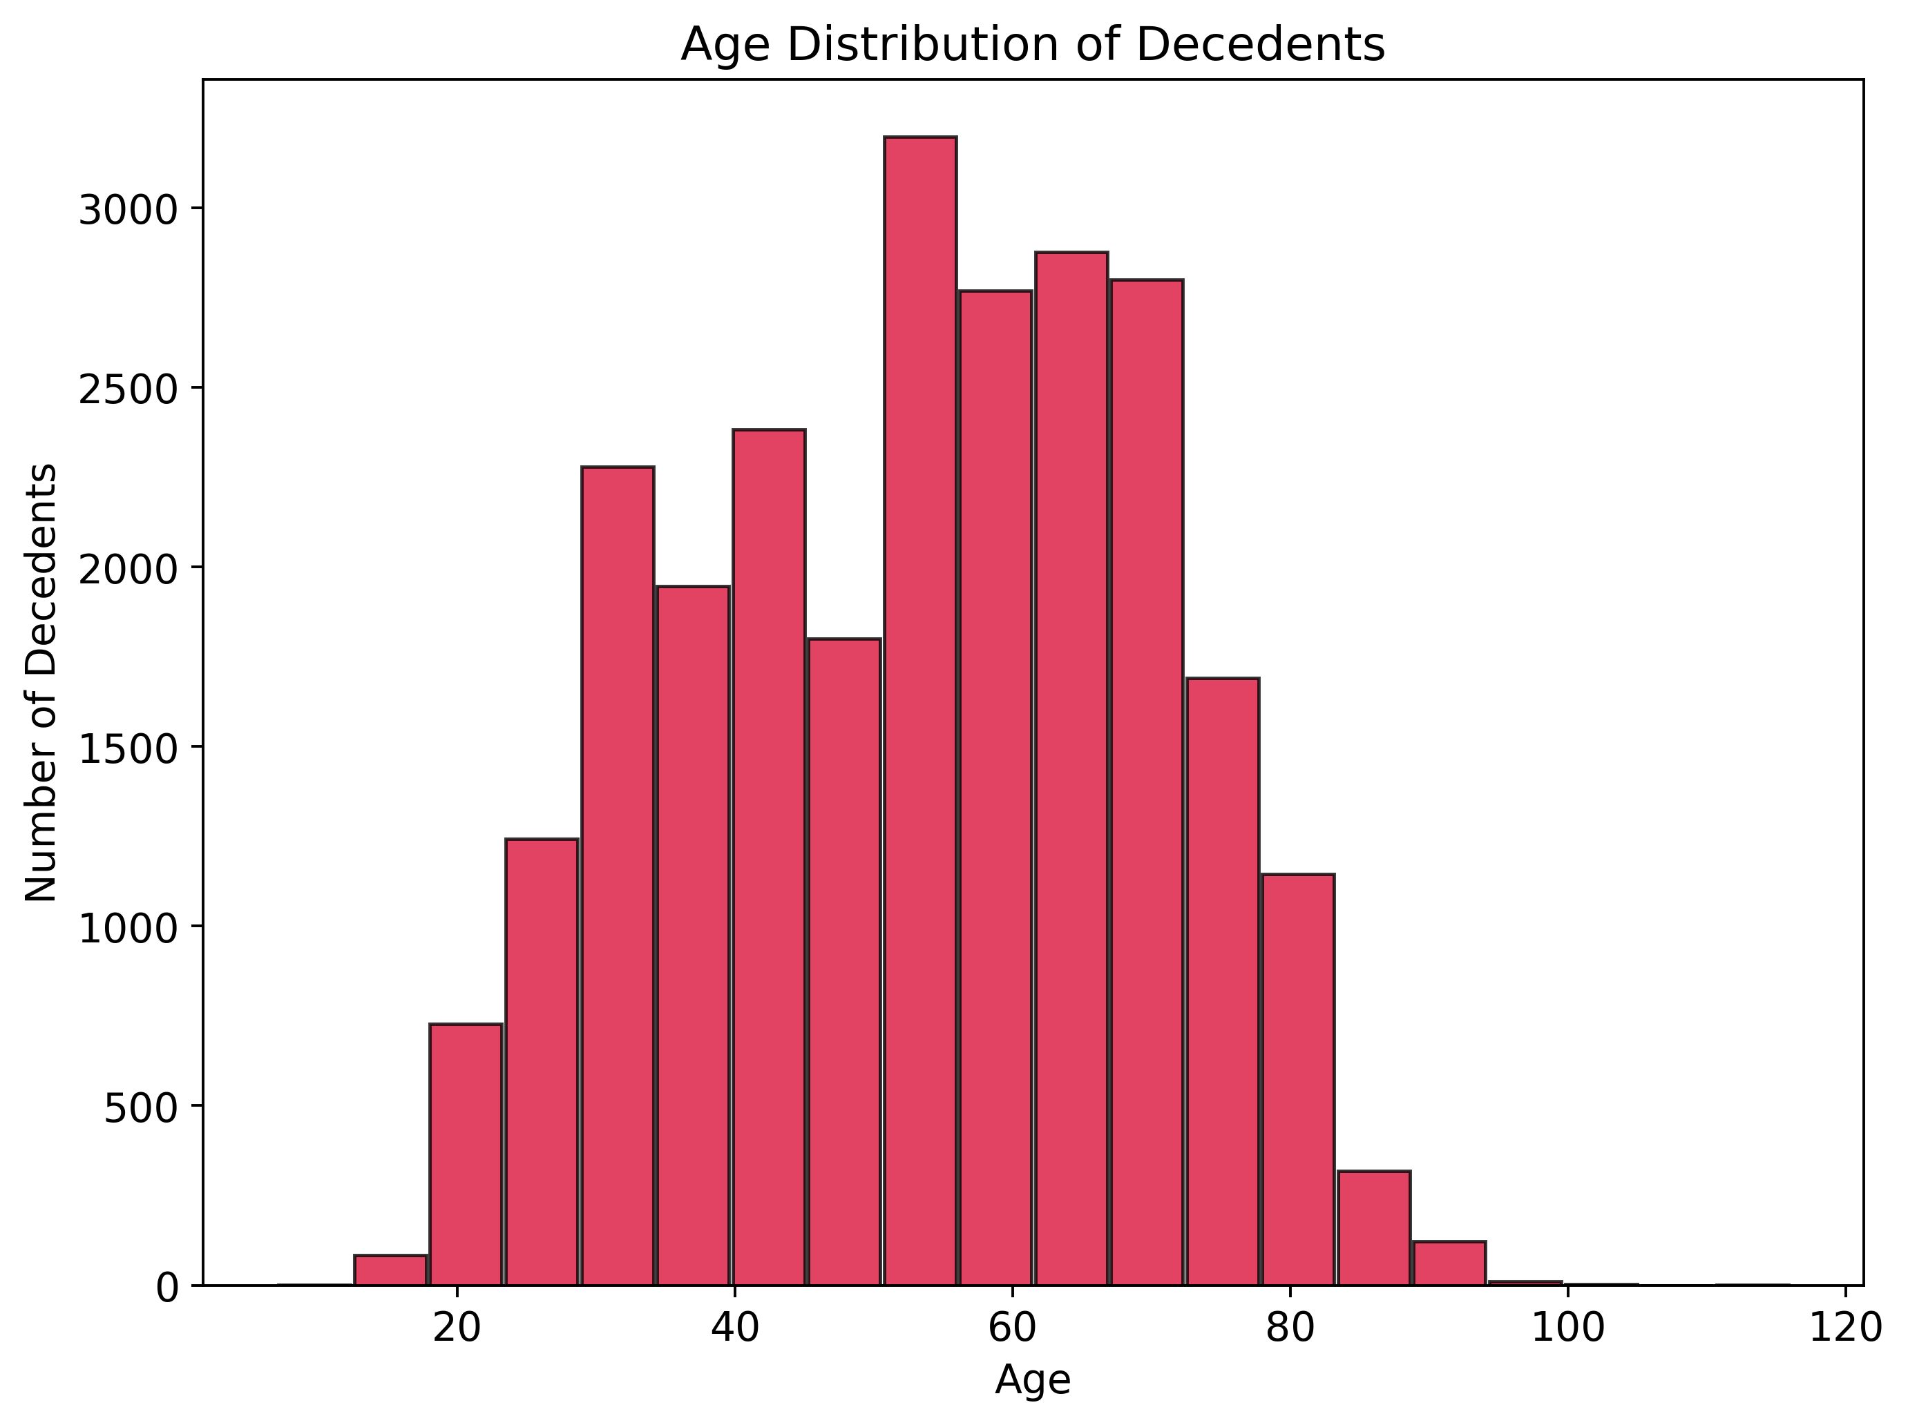
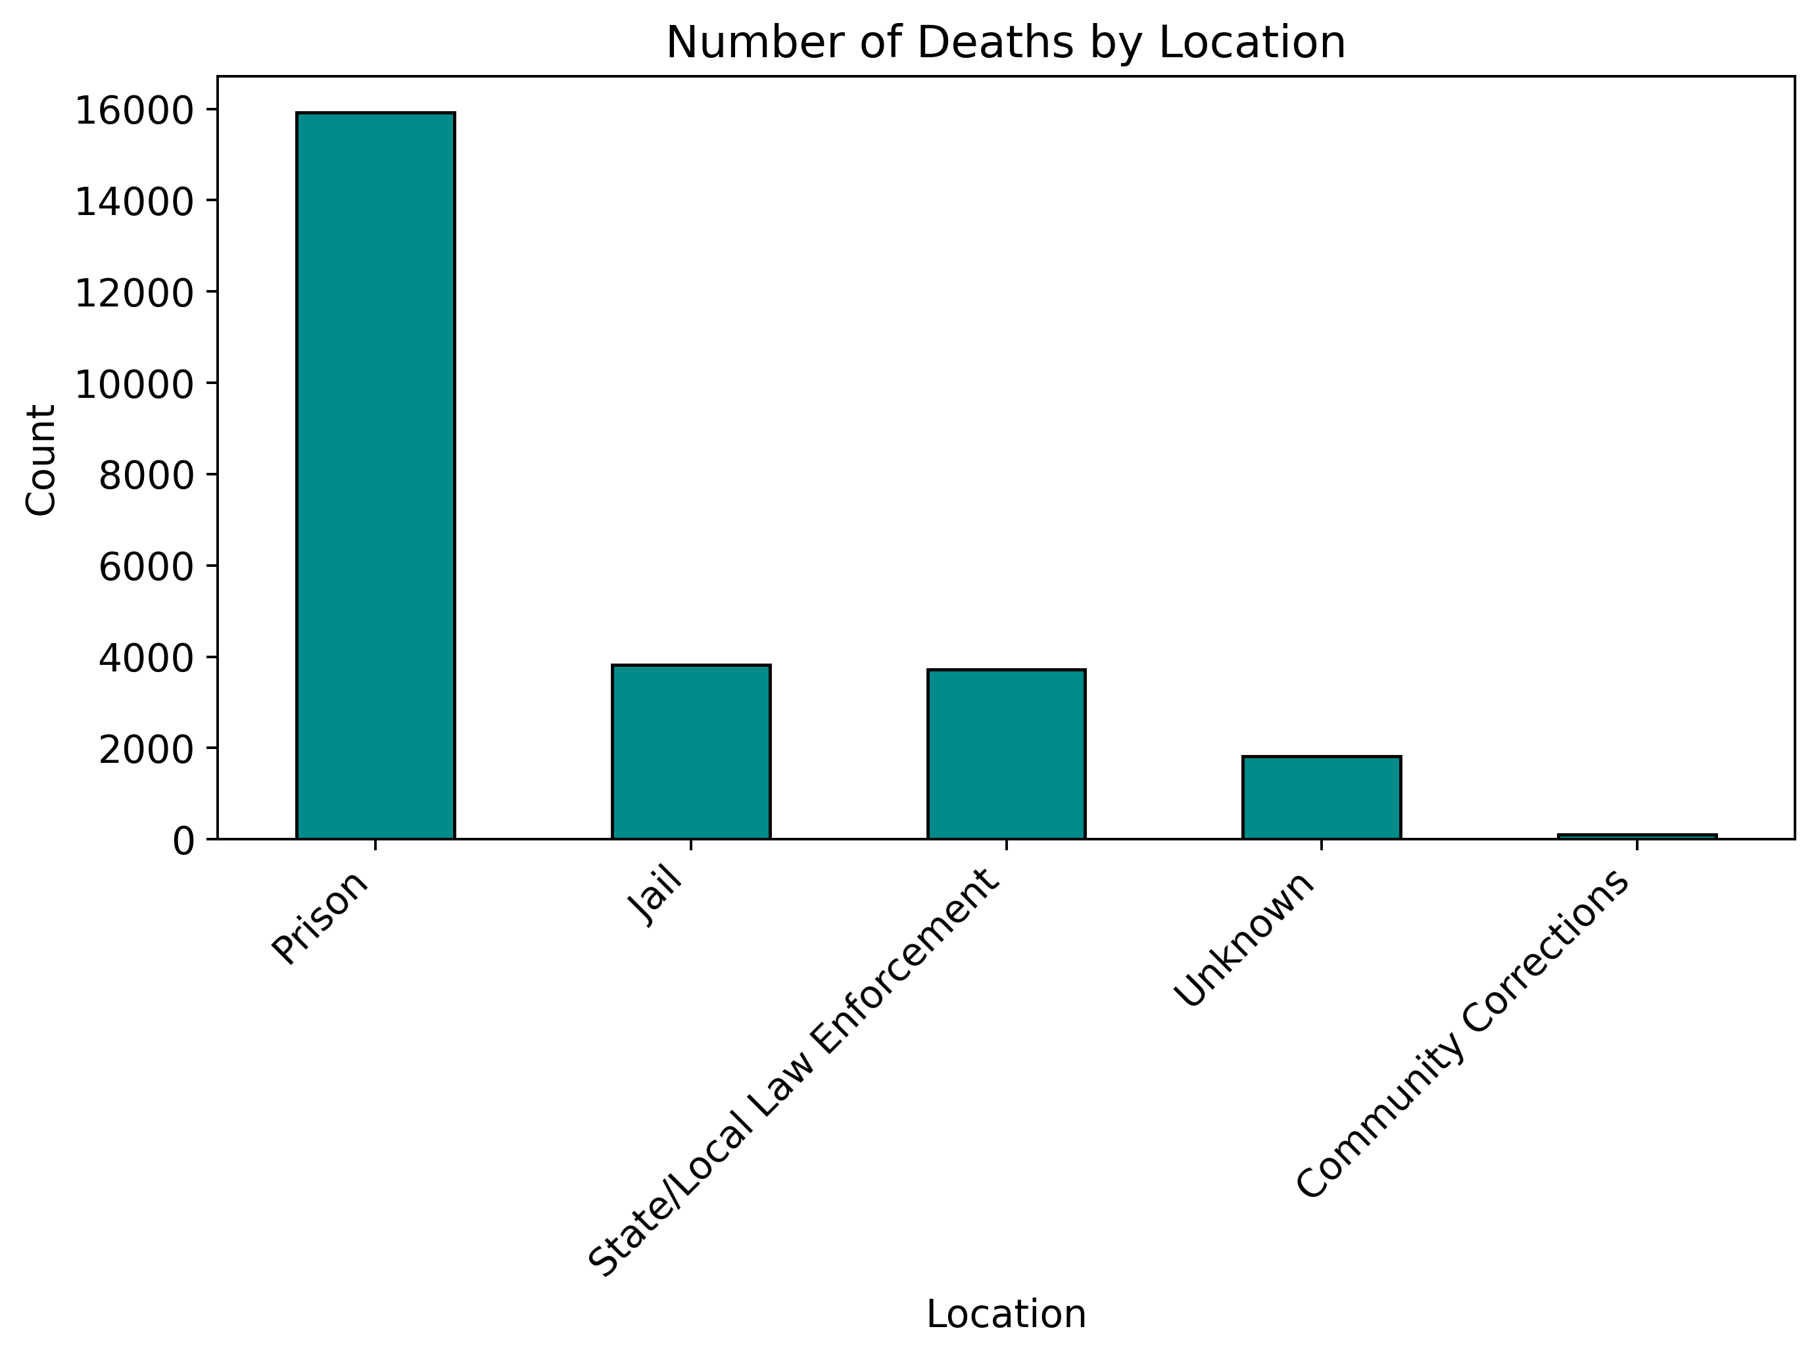
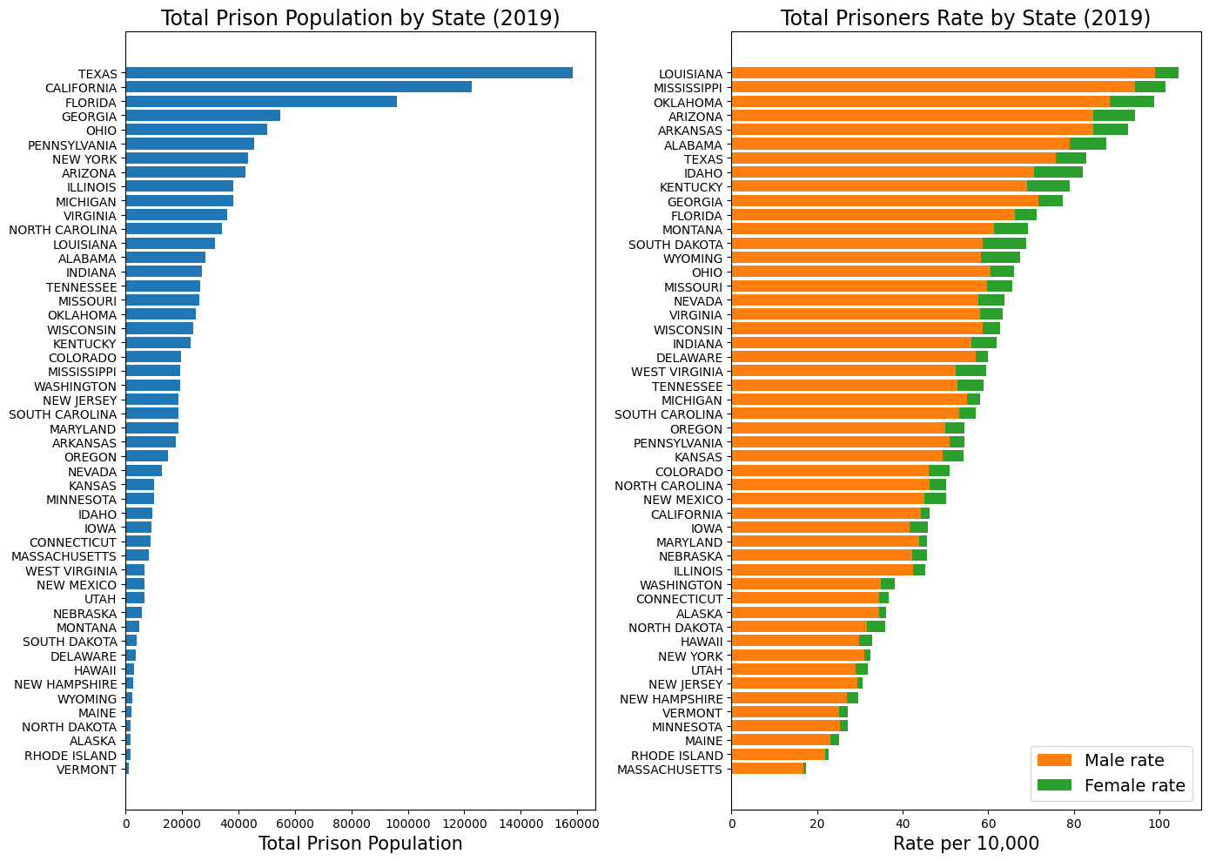
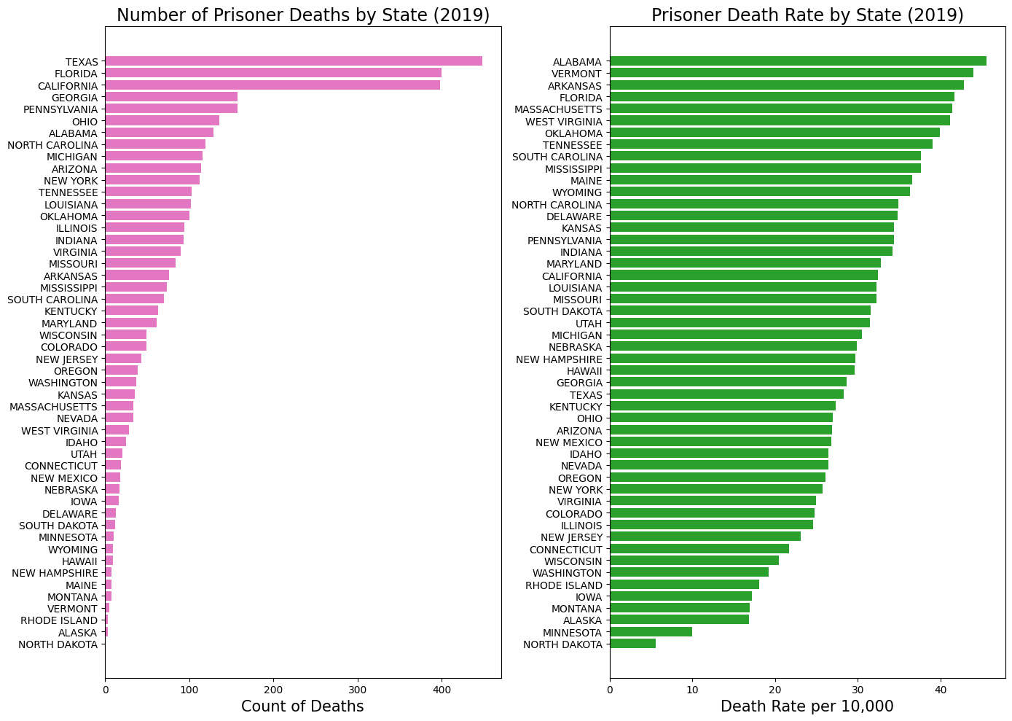
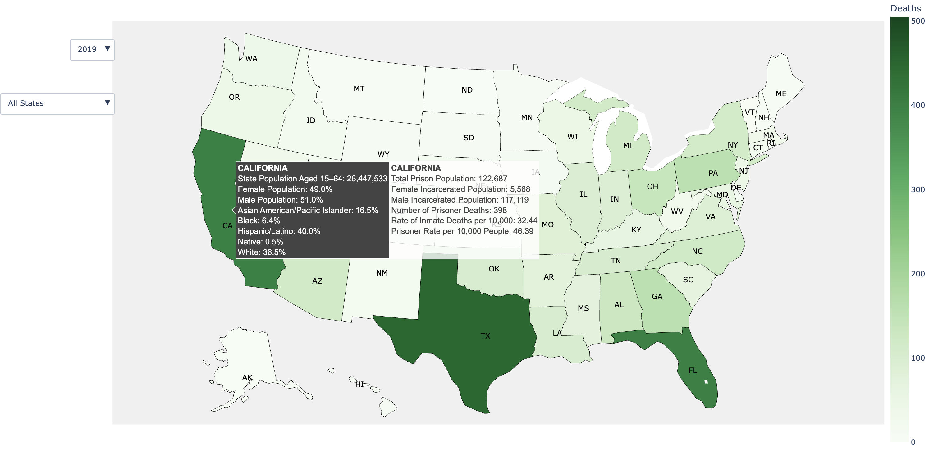


Linking & Analyzing Data on Deaths in US Prisons
Ramil Mammadov, Johnathan Ross, Sam Grossman
INTRODUCTION
EXPLORATORY DATA ANALYSIS
The Death in Custody Reporting Act of 2013 (DCRA) legally requires all U.S. prison systems to report all in-custody deaths to the U.S. Attorney General, along with corresponding circumstantial and demographic information. Until 2019, the Department of Justice (DOJ) would publish this data annually, giving stakeholders vital information regarding prison health trends. However, after administrative failures in data collection and enforcing compliance with the DCRA, the DOJ stopped publishing this data. To address the reporting void, the Third City Project, part of the Bellwether Collective for Health Justice, created the most comprehensive dataset of prisoner deaths by merging federal records with state correctional press releases.
Note: The analysis below is based on BJA records from 2020 to 2023
📊 Prison Death Trends and State-Level Distribution
Prison deaths spiked after 2020, likely due to COVID-19 and limited access to medical care. Counts dipped in 2022, then rose again in 2023. These shifts may reflect reporting delays more than real declines. Overall, the trend shows a sustained increase that calls for closer investigation.
OBJECTIVES
LIMITATIONS
Over 50% of prison deaths come from just 10 states, led by Texas, California, and Florida. This reflects their large overall and prison populations, but also reveals disproportionate regional gaps in incarceration-related mortality across the U.S.
This project focuses on three goals:
Expand the Third City Project database using Department of Corrections press releases from all states and Washington D.C.
Analyze prison mortality trends using data analysis with the Third City Project database.
Build an interactive map to visualize prison death trends and data across U.S. states.
While this project improves public understanding of prisoner deaths by linking multiple data sources, it operates within a fragmented reporting system. Inconsistent death in-custody reporting practices across states and missing data challenge efforts to build a complete picture of national prison mortality.
Key barriers include:
Incomplete or delayed records from states, creating data gaps.
Inconsistent terminology and formats, making comparing different jurisdictions difficult.
Missing demographic and cause-of-death data, limiting analysis.
Many jurisdictions underreport actual deaths, reducing accuracy.
📊 Racial and Gender Disparities in Prison Mortality
Deaths were highest among White (14,000) and Black (8,000) prisoners overall. Most prison deaths occurred among men, reflecting their larger share of the incarcerated population. Over 70% were non-Hispanic, though 20% lacked ethnicity data. These gaps reflect differences in incarceration, care access, and prison conditions, highlighting the need for better demographic reporting.
DATA SOURCES
We use the Third City Project national prison mortality database, which is made up of three critical sources:
State press releases, manually entered via Qualtrics into the Third City Project database, capturing names, dates, death causes.
Bureau of Justice Statistics (BJS) data, with standardized causes and demographics.
Bureau of Justice Assistance (BJA) records from the Deaths in Custody Reporting Program (DCRA), with varying formats across states.
📊 Prison Mortality Snapshot
Most deaths are from natural causes, in older prisoners, and inside state prisons – pointing to chronic illness and poor access to care as primary drivers.
INTERACTIVE MAP
Note: The map was built using the BJS dataset from 2015 to 2019, as it provided more complete and standardized data compared to the BJA records.
A central feature of this project is an interactive map visualizing prisoner deaths alongside other incarceration metrics across all states. Users can filter by year and state, with a color scale showing the number of deaths. Hovering over a state reveals two panels: general population data (age, gender, race) and prison data, including population, deaths, death rate, and imprisonment rate. This tool supports the Third City Project’s mission to provide stakeholders with comprehensive, easily accessible knowledge regarding prison health.
INTERACTIVE MAP OVERVIEW
Based on the interactive map, 2019 data shows that Texas, California, and Florida lead in total prison population and deaths. But Louisiana, Mississippi, and Oklahoma have the highest incarceration rates, while Alabama, Vermont, and Arkansas have the highest death rates per 10,000 prisoners. This shows how smaller states may look worse by rate, underscoring the value of population-based comparisons for revealing system-level disparities.
FUTURE WORK
Link federal & state records; update the 3rd City database via Qualtrics.
Finalize BJA data (2020–2024) for analysis and integration.
Enhance the interactive map and prepare for public release.
Use statistical and ML models to continue analyzing mortality trends.
Collaborate with Third City to improve the platform and draft policy briefs.
References
United States. Bureau of Justice Statistics. National Prisoner Statistics, [United States], 1978-2022. Inter-university Consortium for Political and Social Research [distributor], 2024-01-10. https://doi.org/10.3886/ICPSR38871.v1
United States. Prison Policy Initiative. Appendix: State and federal prison populations 2019-2023 and sources. Prison Policy Initiative [distributor], n.d. https://www.prisonpolicy.org/data/prison_pops_2019_2023_sources.html
Acknowledgements
Thank you to David Cloud, Lauren Brinkley-Rubinstein and Abdul Wasai for their guidance and support throughout the project!

